Slide 1
Project Stockbet
Michelle Lai
General Assembly Web Development Immersive Summer 2017

Slide 2
What’s Inside
Process
Specification doc
User stories
Wireframes
Problemsss...
“require” in the browser…?
Cross-origin issues
Good takeaways

Slide 3
Process

Slide 4
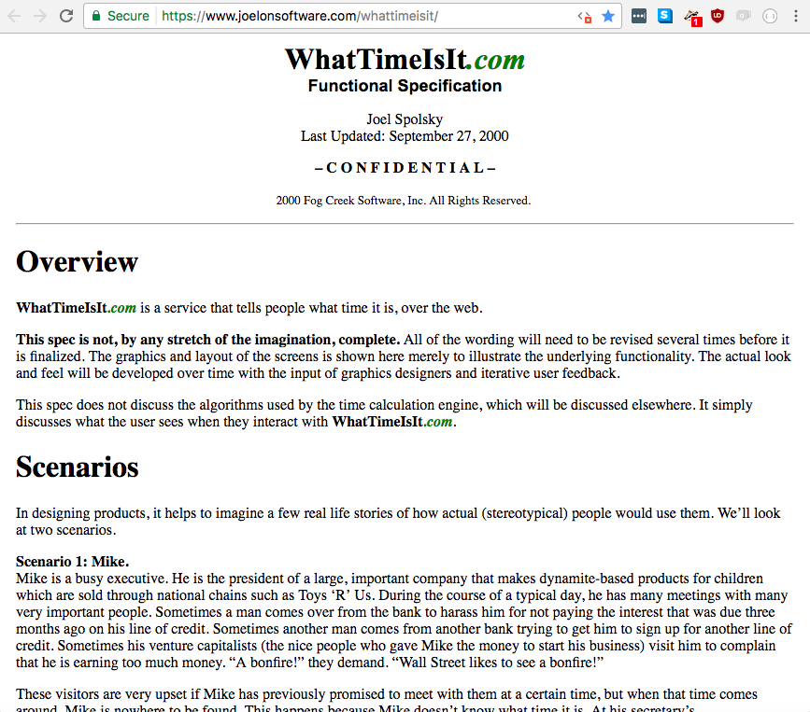
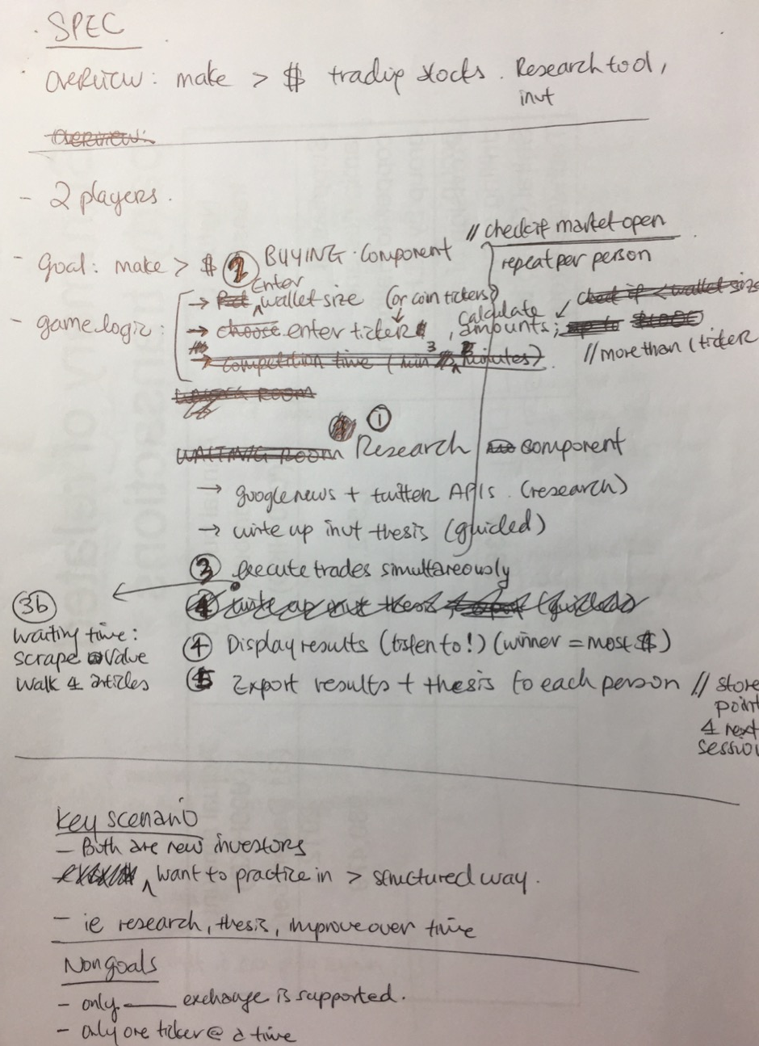
Creating the Spec

Slide 5
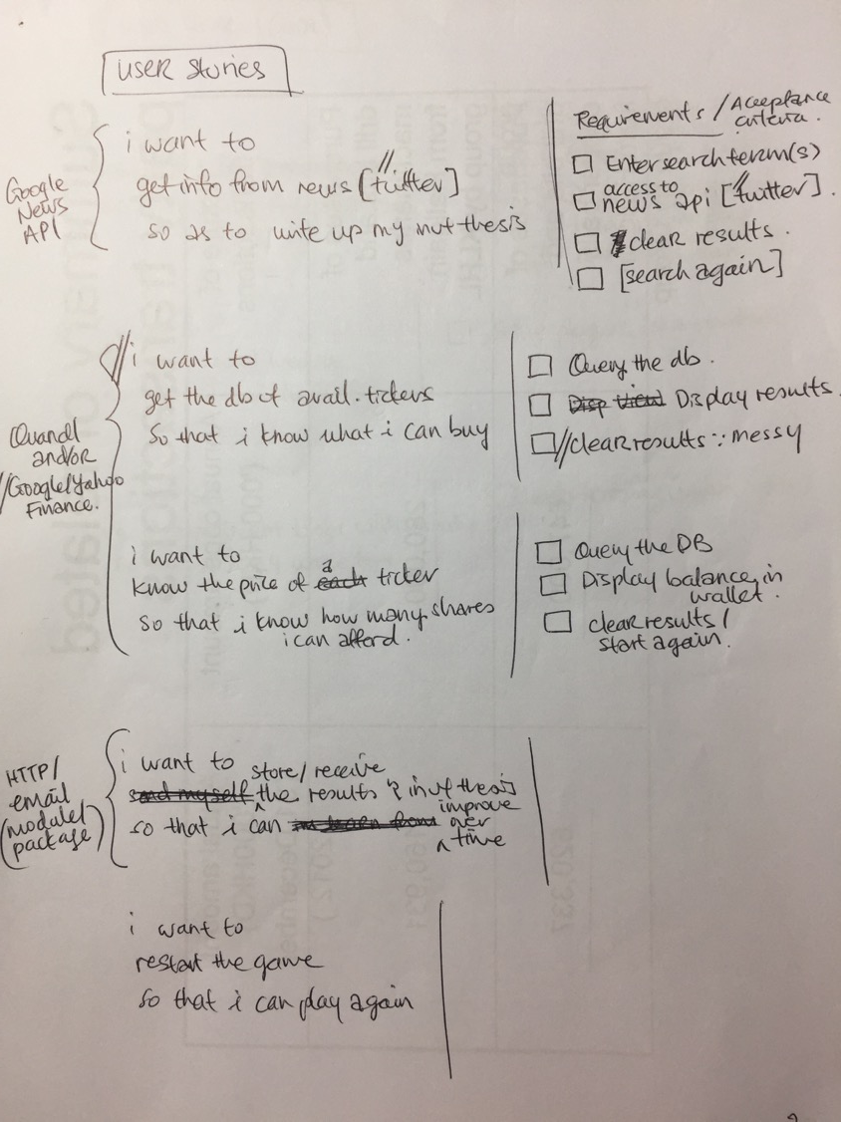
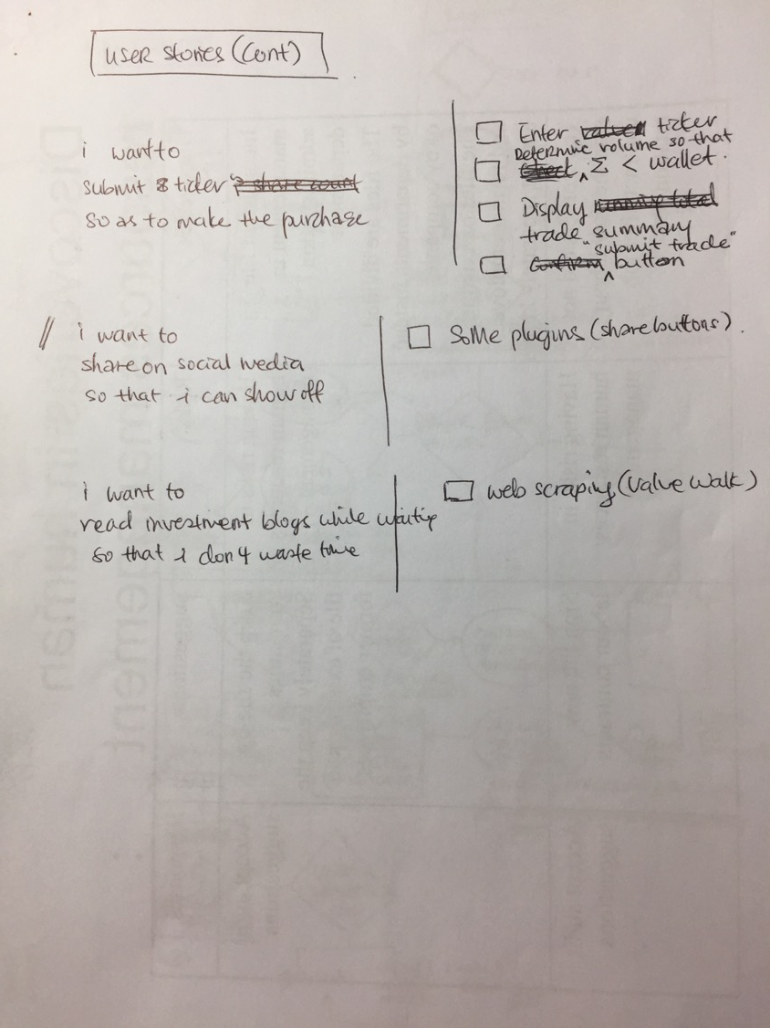
User Stories

Slide 6
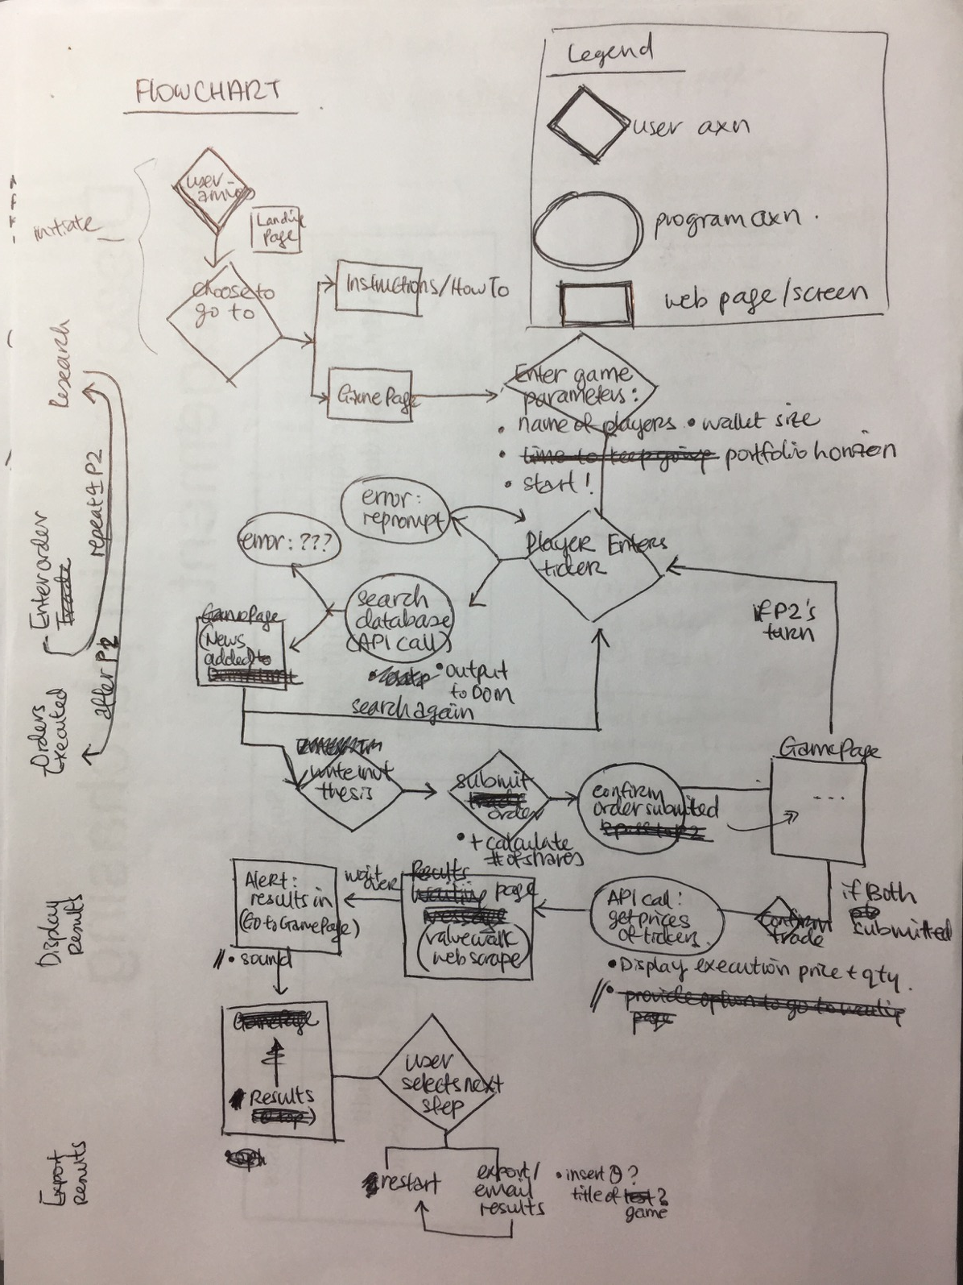
Flowchart

Slide 7
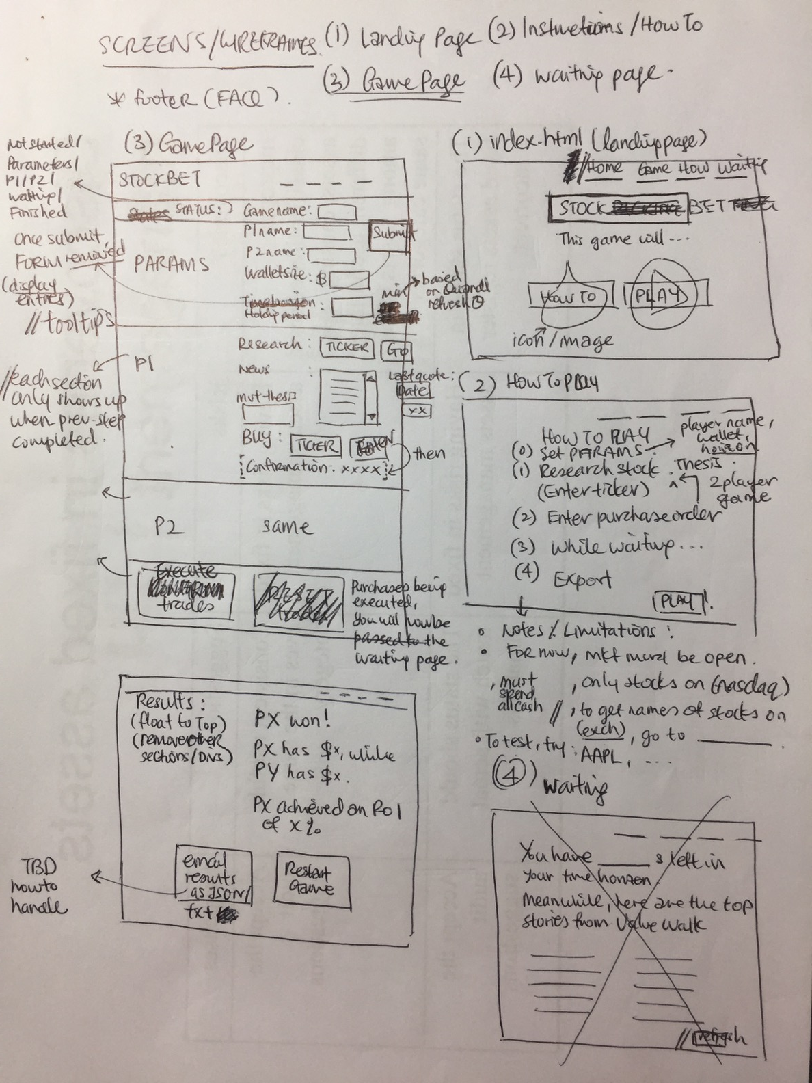
(a sorry excuse for)
Wireframes

Slide 8
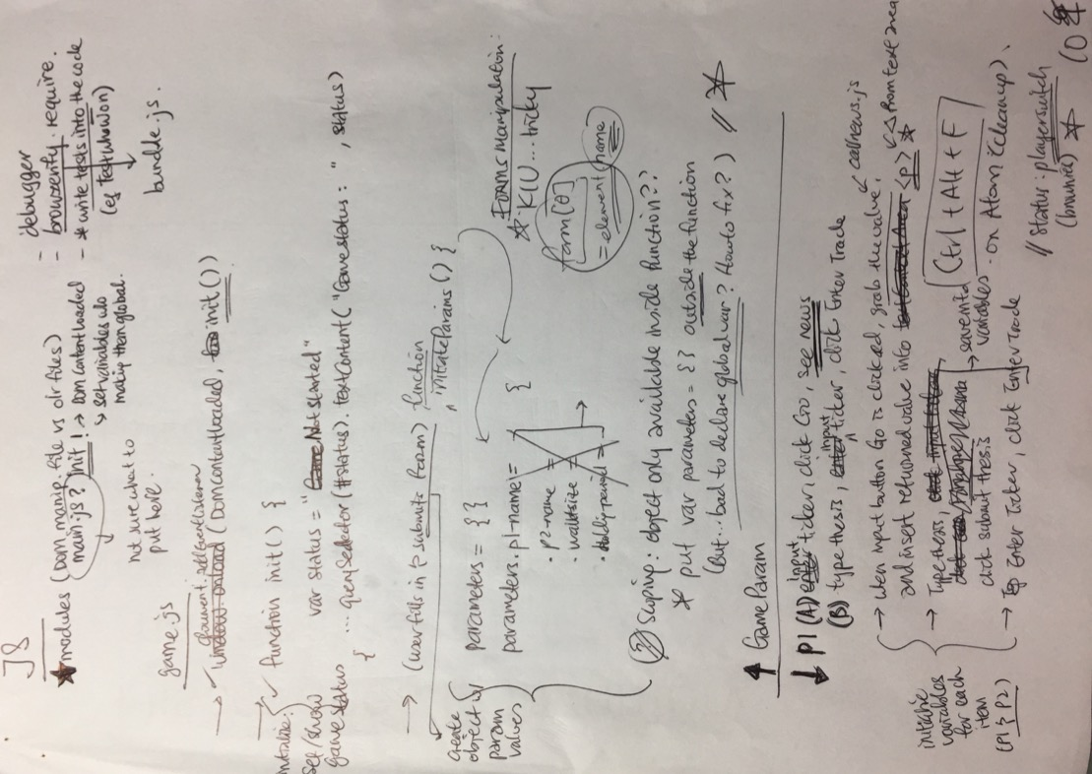
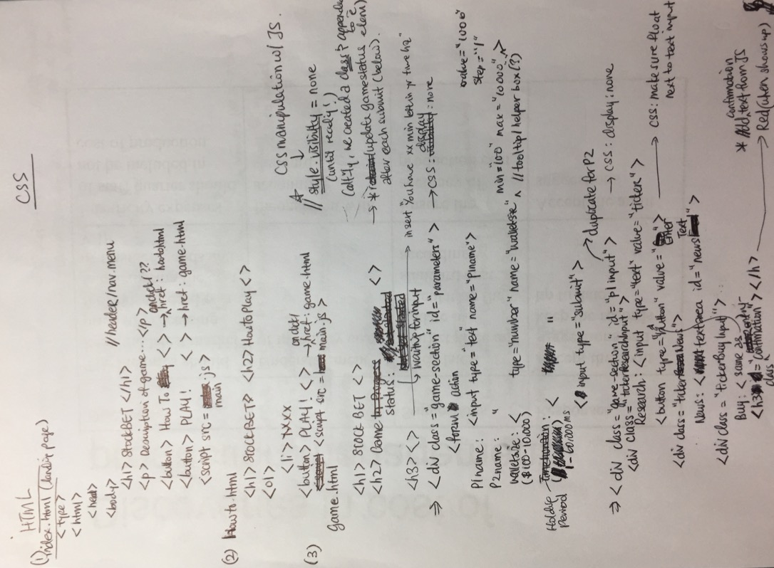
Pseudo-Code

Slide 9
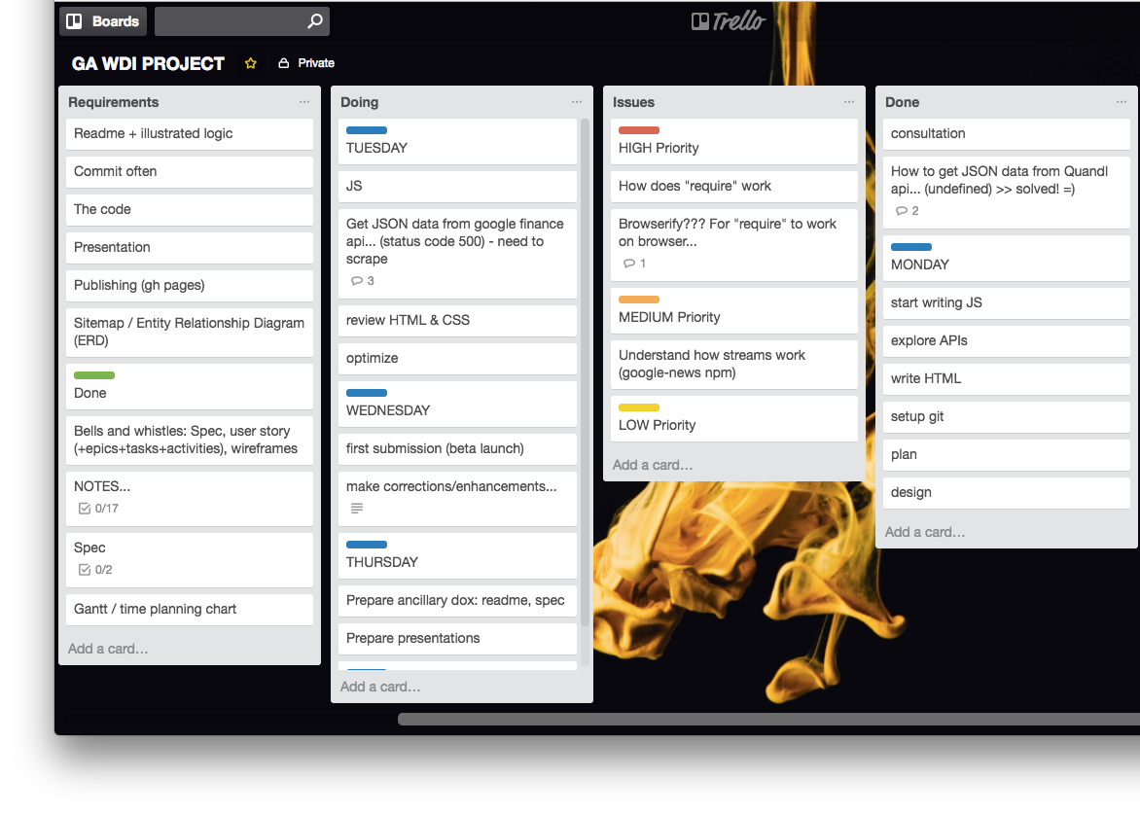
Planning

Slide 10
Problemsss…

Slide 11
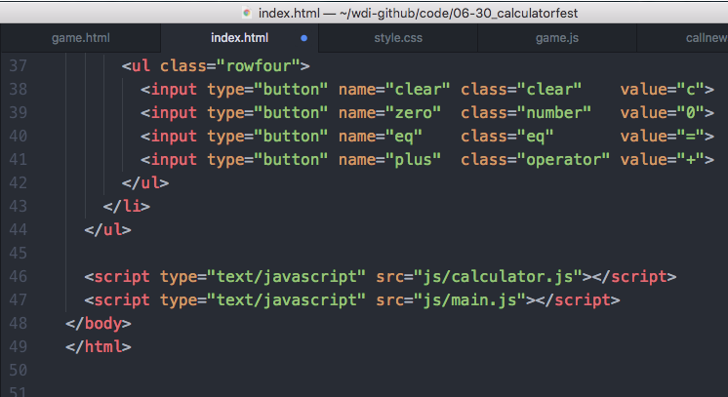
Problem: One JS File (main.js) Refers to Functions/ Variables in Another JS File (referhere.js)
Solution from calculatorfest project:
in the HTML, load referhere.js BEFORE main.js

Slide 12
But I Want To Test Code in Shell
(because faster!*)
Open Live Server
Open Inspector
Click to Console
And when objects/arrays are returned, have to clickclickclick to get to the desired property/element.
$ node game.js
vs
* Especially if I want to use “debugger” / node debug main.js

Slide 13
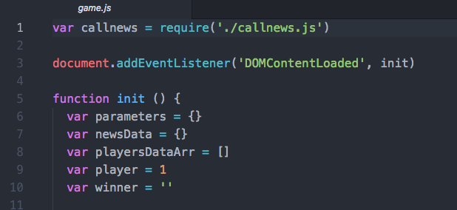
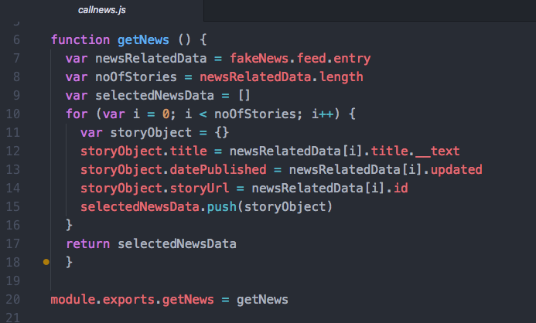
So I Rub the “require” Genie

Slide 14
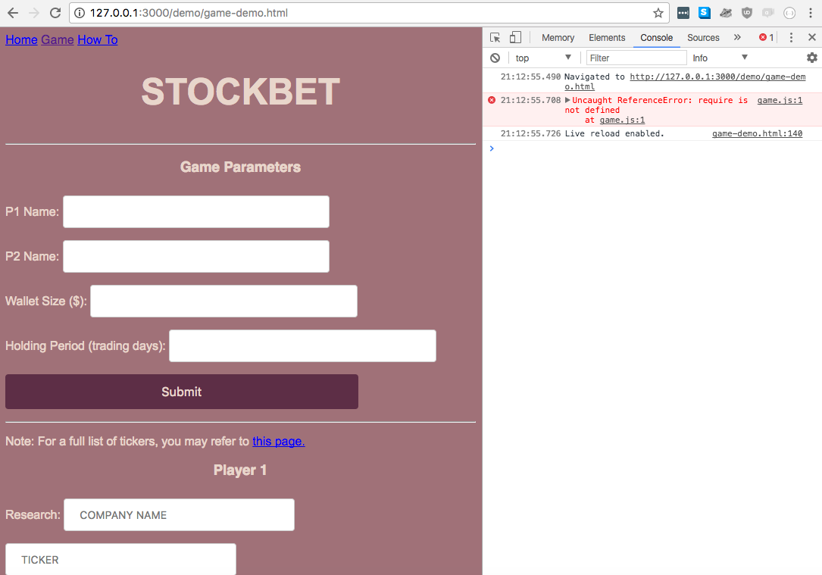
Browser Don’t Get Me
‘require’ => what?

Slide 16
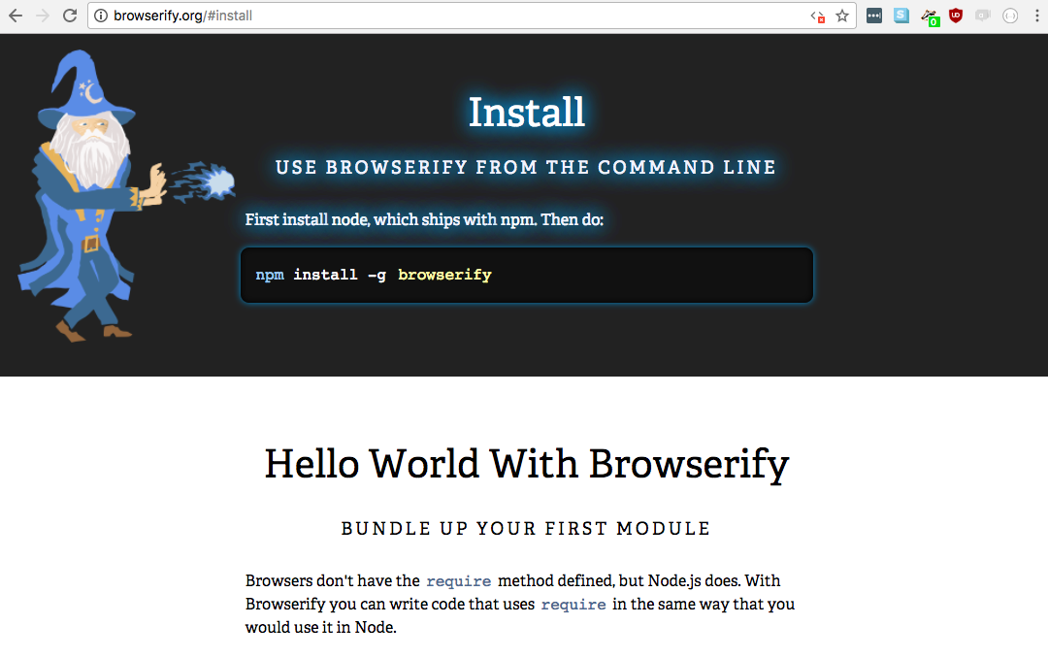
browserify saves my a55

Slide 17
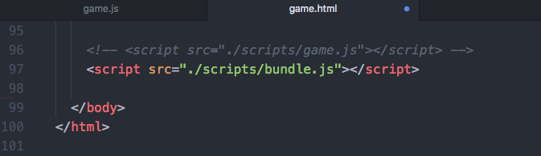
How to browserify
$ browserify main.js –o bundle.js

Slide 18
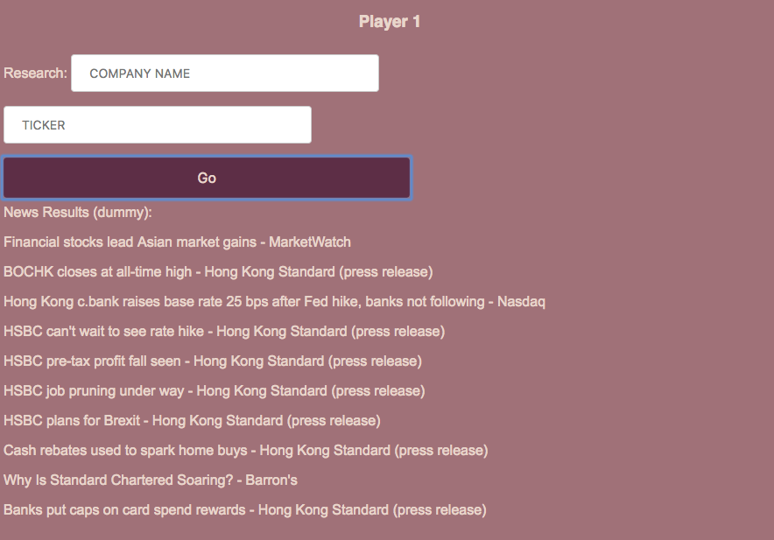
Problem: I want to use npm google-news to draw data on companies
I want this:
This should be based on the COMPANY NAME and TICKER input above

Slide 19
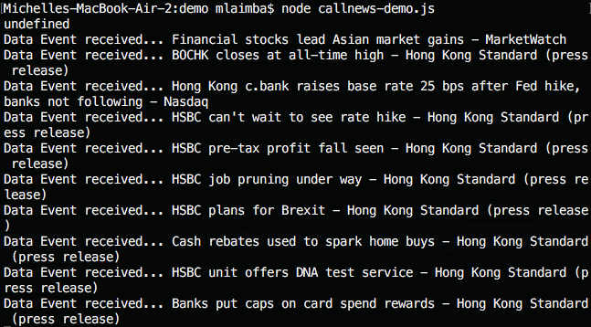
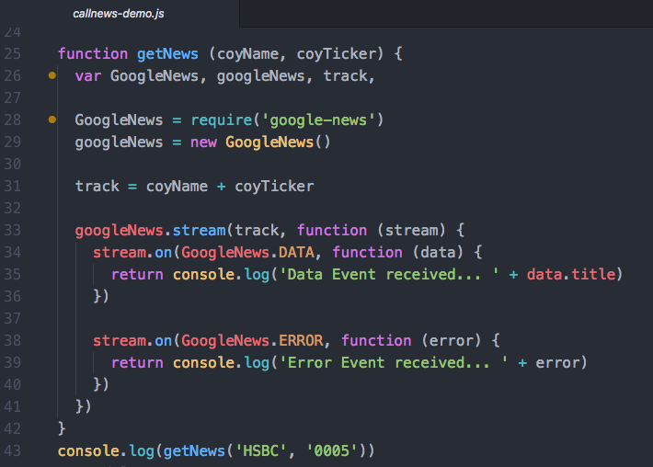
Seems To Work Fine…
$ npm install google-news

Slide 20
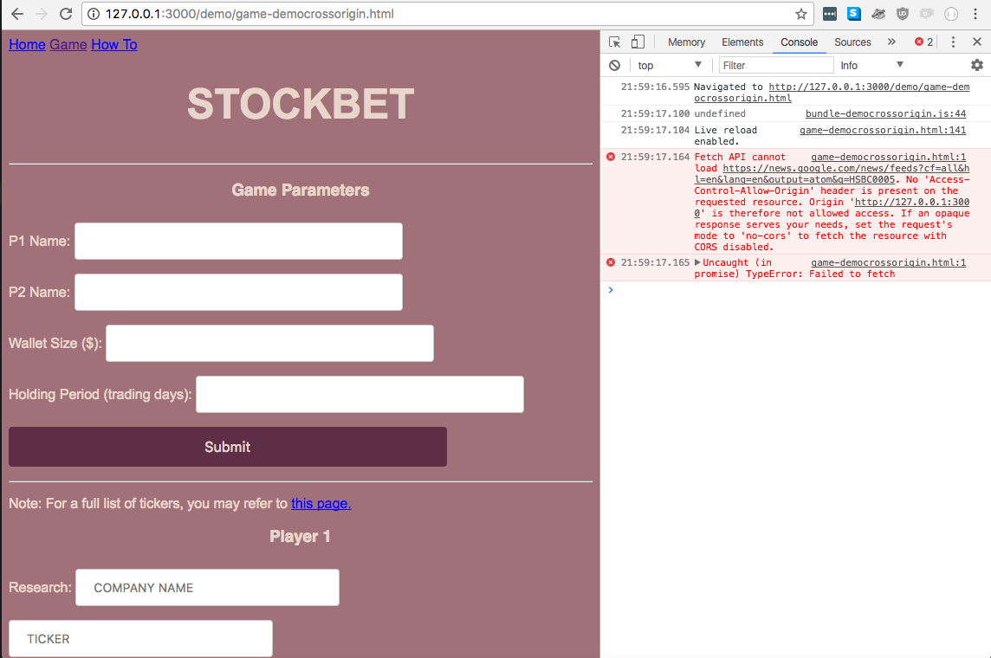
…until i load the browser. AGAIN!
No ‘Access-Control-Allow-Origin’ header is present...

Slide 22
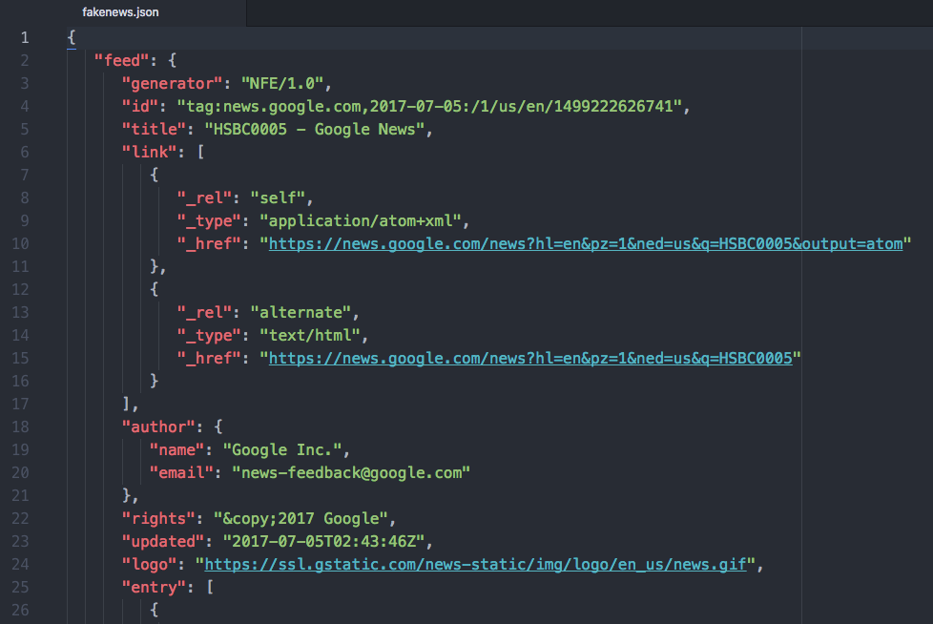
Solution: Fake JSON News Data
(copied from real news data)

Slide 23
Good Takeaways

Slide 24
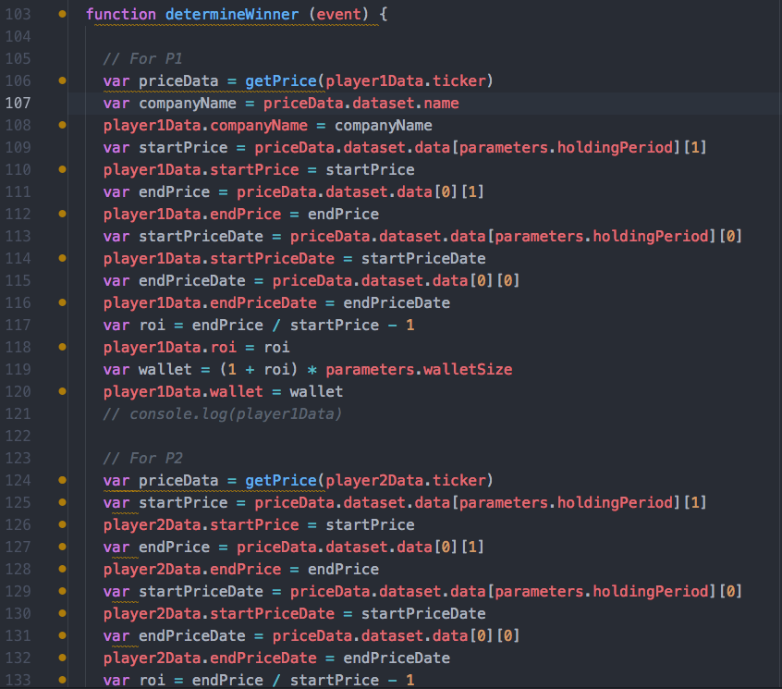
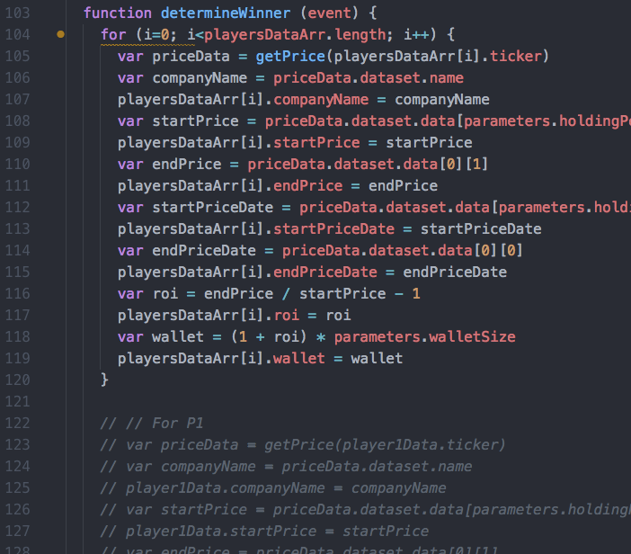
DRY
From 30 lines of code
(and two missed edits ☹ )…
…to 15 lines!

Slide 25
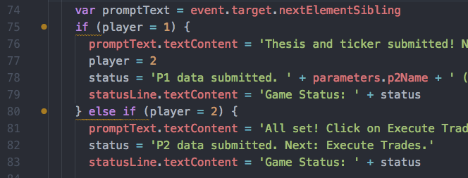
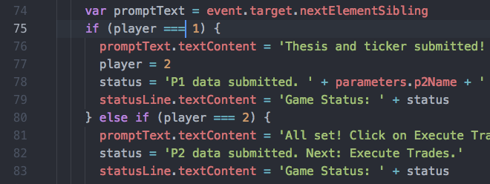
Assigning Instead of Comparing

Slide 26
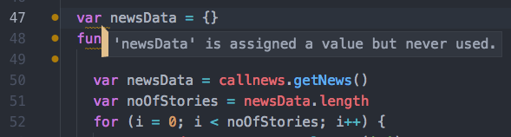
Declaring a Variable More Than Once

Slide 27
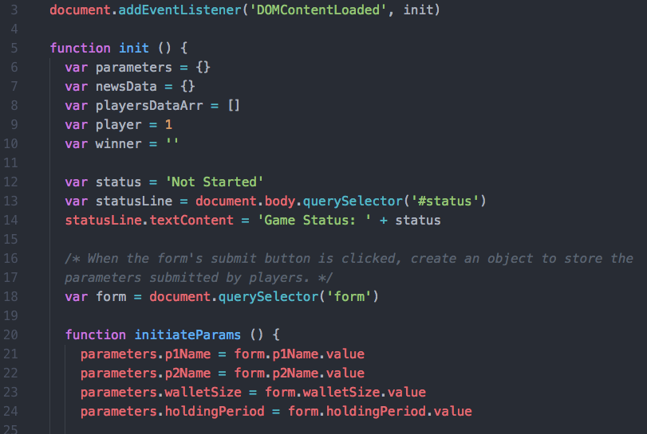
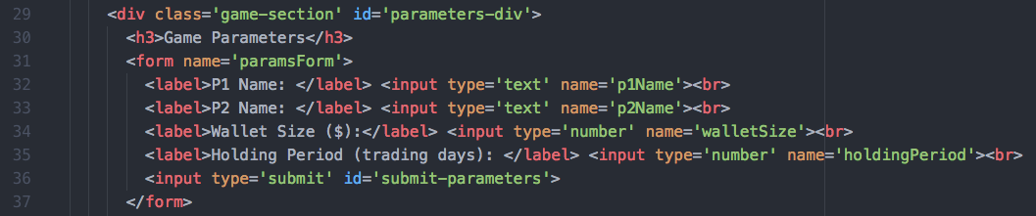
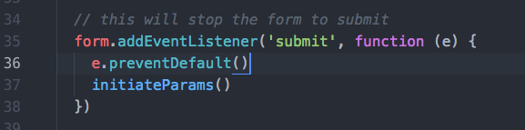
Submitting A Form Reset My Variables ☹
Parameters are reset whenever page is (re)loaded… such as when a <form> is submitted
The form on game.html
Solution!

Slide 28
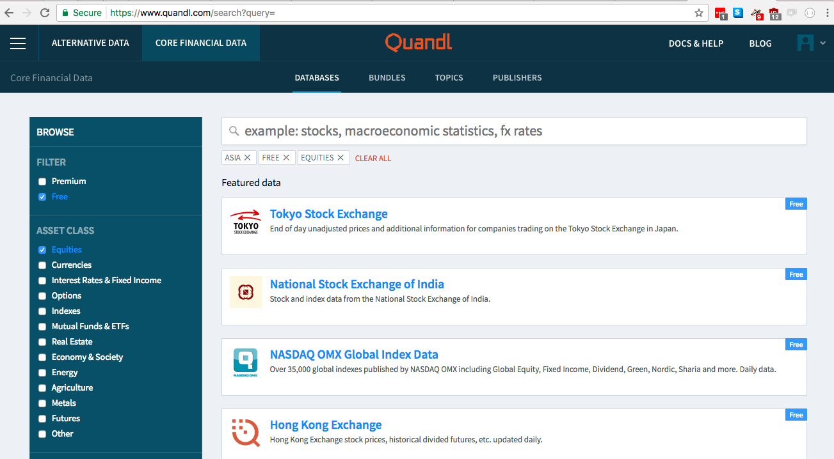
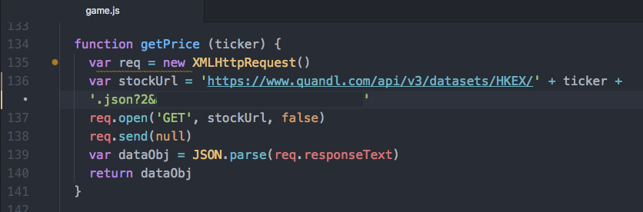
Stock Price Data Source: Quandl

Slide 29
Stock Price Data Source: Quandl

